Slide 1
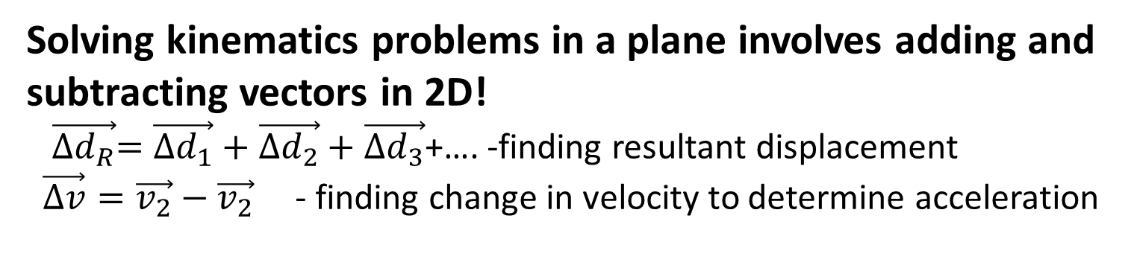
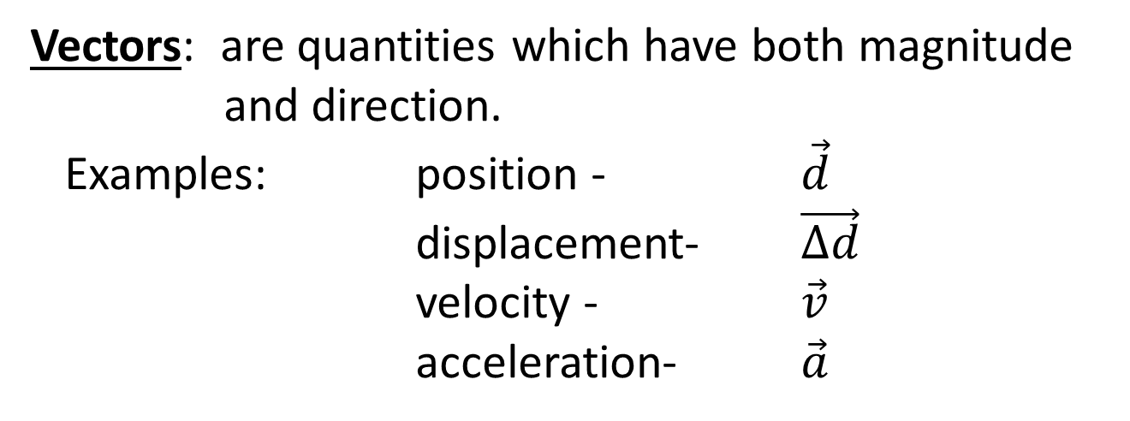
Review of Vector Operations and Analyzing 2D Displacement
Vectors: are quantities which have both magnitude
and direction.
Examples: position - $\vec{d}$
displacement- $\vec{∆d}$
velocity - $\vec{v}$
acceleration- $\vec{a}$
Solving kinematics problems in a plane involves adding and subtracting vectors in 2D!
$\vec{{∆d}_{R}}=\vec{{∆d}_{1}}+\vec{{∆d}_{2}}+\vec{{∆d}_{3}}$+…. -finding resultant displacement
$\vec{∆v}=\vec{v_{2}}−\vec{v_{2}}$ - finding change in velocity to determine acceleration

Slide 2


Vector Notation
Examples of displacement vectors :
N
N
a)
Examples of displacement vectors :
30°
5.0 km
W
E
W
E
45°
$$\vec{∆d}=5.0 km[N30\text{°}E]$$
250.
m
or:
$$\vec{∆d}=5.0 km[E60\text{°}N]$$
S
S
b)
c)
N
N
2.0
km
W
10°
E
W
E
10.0
cm
50°
S
S

Slide 3
Drawing Scale Vector Diagrams
To represent position, displacement and velocity vectors in diagram form, we must choose a scale and draw a reference coordinate system.
Example: Draw vectors representing
A displacement of
500. m [ S 35°W]
b) A velocity of
25 m/s [ N40 °E]

Slide 4
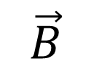
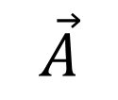
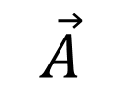
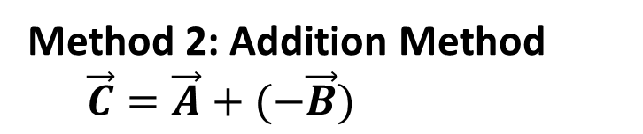
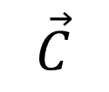
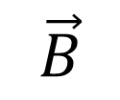
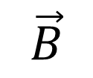
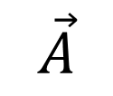
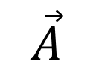
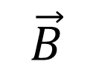
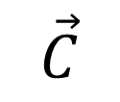
Rules for Adding and Subtracting Vectors
Vector Addition
Vector Subtraction
$$\vec{A}$$
$$\vec{B}$$
=
$$\vec{C}$$
-
$$\vec{A}$$
$$\vec{B}$$
$$\vec{C}$$
+
=
1. Place vectors “tail to tip”
Method 1:
Place vectors “tail to tail”
Resultant “points to initial”
acronym (PIN)
2. Draw resultant from
start to finish
$$\vec{A}$$
$$\vec{B}$$
$$\vec{A}$$
$$\vec{B}$$
Method 2: Addition Method
$\vec{C}=\vec{A}+(−\vec{B})$

Slide 5
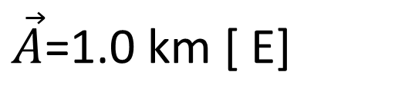
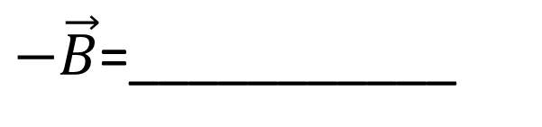
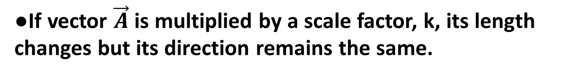
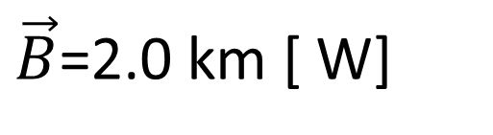
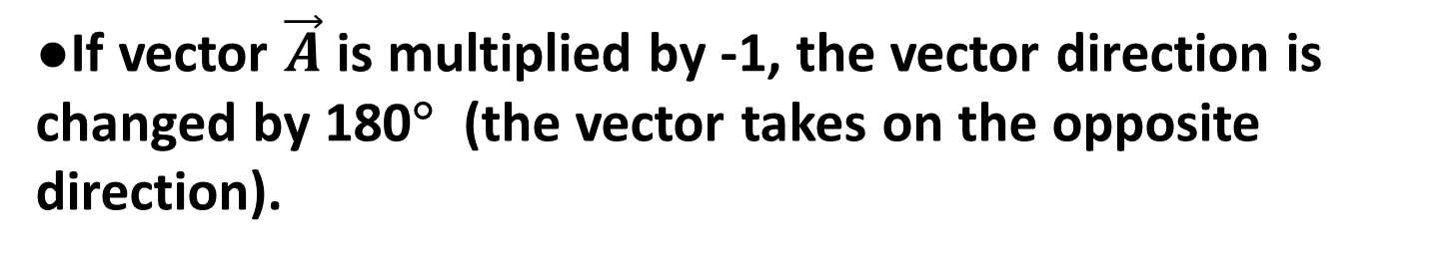
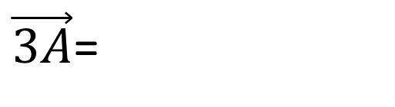
Scalar Multiples of Vectors
●If vector $\vec{A}$ is multiplied by a scale factor, k, its length changes but its direction remains the same.
$\vec{A}$=1.0 km [ E]
Example:
$\vec{3A}$=
●If vector $\vec{A}$ is multiplied by -1, the vector direction is changed by 180° (the vector takes on the opposite direction).
$\vec{B}$=2.0 km [ W]
Example:
$−\vec{B}$=___________

Slide 6
Scalar Multiples of Vectors
●If vector $\vec{A}$ is multiplied by a scale factor, k, its length changes but its direction remains the same.
$\vec{A}$=1.0 km [ E]
Example:
$\vec{3A}$=
3.0 Km [E]
●If vector $\vec{A}$ is multiplied by -1, the vector direction is changed by 180° (the vector takes on the opposite direction).
$\vec{B}$=2.0 km [ W]
Example:
$−\vec{B}$=___________
2.0 Km [E]

Slide 7
Adding Displacement Vectors using a Scale Diagram
Example 1: A bird travels 4.8 km [N 50.°E] and then 3.9 km[E35 °S].
Find the bird’s resultant displacement using a scale diagram.

Slide 8
Example 2: A jogger runs 3.9 km [ North] and 5.7 km [ West]. Find the jogger’s resultant displacement using a sketch and algebraic analysis.
Adding Displacement Vectors using a Sketch Pythagorean Theorem

Slide 9
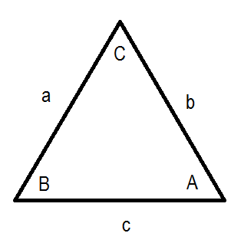

Adding Displacement Vectors using a Sketch and Cosine/Sine Laws
Cosine Law:
$$c^{2}=a^{2}+b^{2}−2ab\cos{C}$$
$$\frac{\sin{A}}{a}=\frac{\sin{B}}{b}=\frac{\sin{C}}{c}$$
Sine Law:
Example 3: A bird travels 4.8 km [N 50.°E] and then 3.9 km[E35 °S]. Find the bird’s resultant displacement algebraically by applying the Cosine and Sine Laws.

Slide 10
Adding Displacement Vectors using a Sketch and Cosine/Sine Laws
Cosine Law:
$$c^{2}=a^{2}+b^{2}−2ab\cos{C}$$
$$\frac{\sin{A}}{a}=\frac{\sin{B}}{b}=\frac{\sin{C}}{c}$$
Sine Law:
Example 3: A bird travels 4.8 km [N 50°E] and then 3.9 km[E35°S]. Find the bird’s resultant displacement algebraically by applying the Cosine and Sine Laws.
4.8 Km
50°

Slide 11
Adding Displacement Vectors using a Sketch and Cosine/Sine Laws
Cosine Law:
$$c^{2}=a^{2}+b^{2}−2ab\cos{C}$$
$$\frac{\sin{A}}{a}=\frac{\sin{B}}{b}=\frac{\sin{C}}{c}$$
Sine Law:
Example 3: A bird travels 4.8 km [N 50°E] and then 3.9 km[E35°S]. Find the bird’s resultant displacement algebraically by applying the Cosine and Sine Laws.
35°
4.8 Km
3.9 Km
50°

Slide 12
Adding Displacement Vectors using a Sketch and Cosine/Sine Laws
Cosine Law:
$$c^{2}=a^{2}+b^{2}−2ab\cos{C}$$
$$\frac{\sin{A}}{a}=\frac{\sin{B}}{b}=\frac{\sin{C}}{c}$$
Sine Law:
Example 3: A bird travels 4.8 km [N 50°E] and then 3.9 km[E35°S]. Find the bird’s resultant displacement algebraically by applying the Cosine and Sine Laws.
35°
4.8 Km
3.9 Km
50°

Slide 13
Adding Displacement Vectors using a Sketch and Cosine/Sine Laws
Cosine Law:
$$c^{2}=a^{2}+b^{2}−2ab\cos{C}$$
$$\frac{\sin{A}}{a}=\frac{\sin{B}}{b}=\frac{\sin{C}}{c}$$
Sine Law:
Example 3: A bird travels 4.8 km [N 50°E] and then 3.9 km[E35°S]. Find the bird’s resultant displacement algebraically by applying the Cosine and Sine Laws.
4.8 Km
105°
3.9 Km

Slide 14
Adding Displacement Vectors using a Sketch and Cosine/Sine Laws
Cosine Law:
$$c^{2}=a^{2}+b^{2}−2ab\cos{C}$$
$$\frac{\sin{A}}{a}=\frac{\sin{B}}{b}=\frac{\sin{C}}{c}$$
Sine Law:
Example 3: A bird travels 4.8 km [N 50°E] and then 3.9 km[E35°S]. Find the bird’s resultant displacement algebraically by applying the Cosine and Sine Laws.
4.8 Km
105°
3.9 Km
42°
33°
6.9 Km

Slide 15
Adding Displacement Vectors using a Sketch and Cosine/Sine Laws
Cosine Law:
$$c^{2}=a^{2}+b^{2}−2ab\cos{C}$$
$$\frac{\sin{A}}{a}=\frac{\sin{B}}{b}=\frac{\sin{C}}{c}$$
Sine Law:
Example 3: A bird travels 4.8 km [N 50°E] and then 3.9 km[E35°S]. Find the bird’s resultant displacement algebraically by applying the Cosine and Sine Laws.
Answer:
6.9 Km [N83°E]
or
6.9 Km [E7°N]
50°
33°
7°
6.9 Km

Slide 16
Vector Components
Vectors can be broken down into “X” and “Y” axis components.
We use basic trigonometry (SOHCAHTOA)
N
30°
5.0 km
W
E
S

Slide 17
Vector Components
Vectors can be broken down into “X” and “Y” axis components.
We use basic trigonometry (SOHCAHTOA)
N
30°
5.0 km
W
E
X-Axis Component
= 5.0 Sin(30°)
= 2.5 Km [E]
S

Slide 18
Vector Components
Vectors can be broken down into “X” and “Y” axis components.
We use basic trigonometry (SOHCAHTOA)
Y-Axis Component
= 5.0 Cos(30°)
= 4.3 Km [N]
N
30°
5.0 km
W
E
S

Slide 19
Vector Components
Calculate The Following Components
  * Assume North is Up
  ** Assume North and East are positive
4.8 Km
50°
35°
3.9 Km

Slide 20
Vector Components
Calculate The Following Components
  * Assume North is Up
  ** Assume North and East are positive
4.8 Km
= 4.8 Cos(50°)
= 3.1 Km [N]
50°
= 3.9 Cos(35°)
= 3.1 Km [E]
= 4.8 Sin(50°)
= 3.7 Km [E]
= 3.9 Sin(35°)
= 2.2 Km [S]
= -2.2Km[N]
35°
3.9 Km

Slide 21
Solving With Vector Components
Example 3: A bird travels 4.8 km [N 50°E] and then 3.9 km[E35°S]. Find the bird’s resultant displacement algebraically by applying the Cosine and Sine Laws.
35°
4.8 Km
3.9 Km
50°
Calculate the X and Y components
Add The Components
Calculate the final vector

Slide 22
Solving With Vector Components
Example 3: A bird travels 4.8 km [N 50°E] and then 3.9 km[E35°S]. Find the bird’s resultant displacement algebraically by applying the Cosine and Sine Laws.
35°
4.8 Km
3.9 Km
50°
Add The Components
  = 3.1 Km [N] + 3.7 Km [E] + 3.1 Km [E] – 2.2 Km [N]
  = 3.1 Km [N] – 2.2 Km [N] + 3.7 Km [E] + 3.1 Km [E]
  = 0.9 Km [N] + 6.8 Km [E]

Slide 23
Solving With Vector Components
Example 3: A bird travels 4.8 km [N 50°E] and then 3.9 km[E35°S]. Find the bird’s resultant displacement algebraically by applying the Cosine and Sine Laws.
0.9 Km [N]
6.8 Km [E]
Calculate The Final Vector
  = 0.9 Km [N] + 6.8 Km [E]

Slide 24
Solving With Vector Components
Example 3: A bird travels 4.8 km [N 50°E] and then 3.9 km[E35°S]. Find the bird’s resultant displacement algebraically by applying the Cosine and Sine Laws.
a² + b² = c²
6.9 Km
0.9 Km [N]
6.8 Km [E]
Calculate The Final Vector
  = 0.9 Km [N] + 6.8 Km [E]

Slide 25
Solving With Vector Components
Example 3: A bird travels 4.8 km [N 50°E] and then 3.9 km[E35°S]. Find the bird’s resultant displacement algebraically by applying the Cosine and Sine Laws.
Θ= tan⁻¹(0.9/6.8)
6.9 Km
0.9 Km [N]
7°
6.8 Km [E]
Calculate The Final Vector
  = 0.9 Km [N] + 6.8 Km [E]

Slide 26
Solving With Vector Components
Example 3: A bird travels 4.8 km [N 50°E] and then 3.9 km[E35°S]. Find the bird’s resultant displacement algebraically by applying the Cosine and Sine Laws.
Θ= tan⁻¹(0.9/6.8)
6.9 Km
0.9 Km [N]
7°
6.8 Km [E]
ANSWER
  = 6.9 Km [E7°N]

